Slide 1

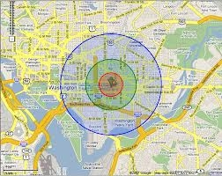
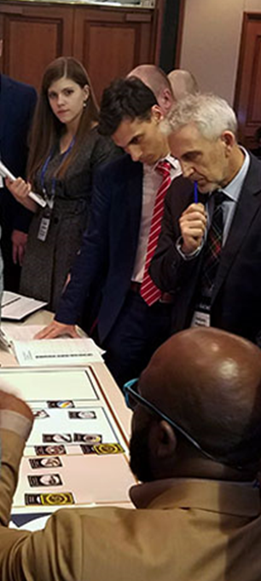

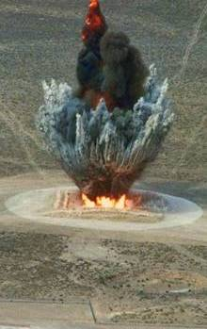
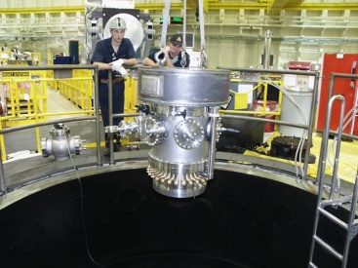
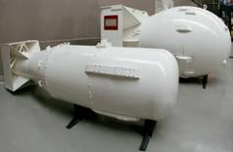
NEST
The Nuclear Emergency Support Team
Bill Reding, RAP 2 Regional Program Manager

Slide 2
Organization
As of April 2024
Department of Energy
Office of the Secretary
Deputy Under Secretary and Associate Administrator for Counterterrorism and Counterproliferation
Kasia Mendelson (Acting)
Deputy Associate Administrator
Rilla Hamilton (Acting)
DOE/NNSA Liaison Program
Combatant Commands:
USEUCOM@, USINDOPACOM@, USFK, USCENTCOM, USSOCOM,
USSOUTHCOM, JSOC (PT)
Interagency:
DTRA, DTRA OAP, DNI/NCBC, USD(I)*, DHS CWMD+
LEGEND:
@Reimbursable *Detailee +LNO to NNSA
National Nuclear Security Administration
Office of the Administrator
NA-80
Jenny Smith, Senior Advisor
Vacant, Senior Policy Advisor*
Mark Scheuer, Chief of Staff
Charmaine Nuñez, Deputy Chief of Staff
Yesenia Vergara, Front Office Analyst
Victor Jones, Front Office Analyst
NA-1
National Nuclear Security Administration
Office of Counterterrorism and Counterproliferation
Office of Nuclear Incident Policy and Cooperation
Paloma Richard, Director
Derek Estes, Deputy Director
Office of Nuclear Threat Science
Chris Smith, Director
Leah Cochran, Deputy Director
Office of Nuclear Forensics
Rick Christensen, Director (Acting)
Vacant, Deputy Director
Office of Nuclear Incident Response
Rick Christensen, Director
Dawn Smith, Deputy Director (Acting)
Michael Peters, Deputy
Director (ABQ)
NA-81
NA-82
NA-83
NA-84

Slide 3
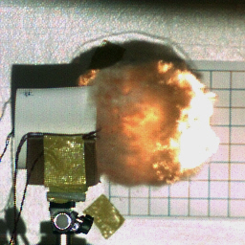
Counterterrorism and Counterproliferation Mission
The Office of Counterterrorism and Counterproliferation is responsible for countering nuclear terrorism and nuclear proliferation and responding to nuclear incidents and accidents domestically and overseas. Missions include
both national security and public health and safety disciplines.
Mission Pillars
Provide scientific understanding of potential nuclear threat devices
and proliferant state nuclear capabilities.
Deliver expert analysis and technical capabilities for national counterproliferation efforts.
Inform U.S. and international policies on terrorist and proliferant state nuclear threats.
Sustain Nuclear Emergency Support Team (NEST) readiness to respond to nuclear and radiological incidents and accidents worldwide.
Maintain and advance a robust nuclear forensic capability to deter nuclear terrorism and nuclear smuggling and support attribution of a broad range of nuclear incidents.
Provide targeted training to domestic and international partners on
emergency preparedness and response.

Slide 4

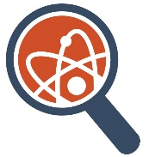
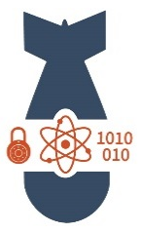

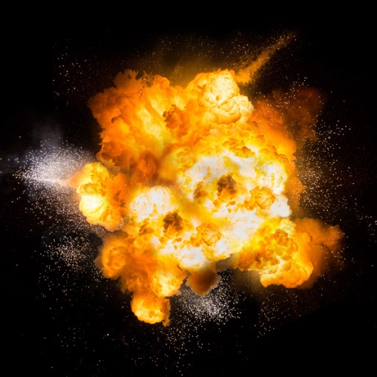
NA 80 – Programs & Assets Working Together!
NA-81
Office of Nuclear Incident Policy and Cooperation
NA-82
Office of
Nuclear
Threat
Science
NA-83
Office of Nuclear Forensics
NA-84
Office of
Nuclear
Incident
Response
Global Capacity
Building
Material Security & Threat Science
Detection & Secure
Consequence Management Planning
Device Defeat & Hazard Mitigation
Pre-Det
Forensics/
Attribution
Incident
Occurs
Post-Det Forensics/
Attribution
Consequence Management
Intelligence

Slide 5

Nuclear Emergency Support Team (NEST)
Mission
NEST is DOE/NNSA’s flexible, scalable, and tailorable capability to respond to nuclear / radiological incidents and accidents of any size or variety in the United States and abroad.
Counter Weapons of Mass Destruction
NEST protects major public events
NEST supports WMD defeat operations
Provides assessment, disposition and forensic exploitation of nuclear and radiological devices
Nuclear Weapon Accident / Incident Response
NEST responds to accidents involving U.S. nuclear weapons
NEST responds to incidents involving a lost or stolen U.S. nuclear weapon
Public Health & Safety
NEST responds to protect the public from accidents, incidents or other concerns that involve radiological or nuclear material
Nuclear Forensics Response
NEST maintains a forensics response capability in support of pre-detonation nuclear materials, pre-detonation device assessment, and post-detonation debris collections & device assessment

Slide 6
NEST – A Suite of Programs & Assets with Capabilities
Counter Weapons of Mass Destruction
Public Health & Safety
DOE Forensics
Radiological Assistance Program (RAP)
Provide actionable technical advice and scientific assessments to tactical, operational, and senior officials to protect public health and safety during any radiological or nuclear event, threat, incident, or accident.
Nuclear Search Program (NSP)
Provides global field and remote technical and scientific assessments and technical capabilities for detecting radiological and nuclear materials and protecting the public with Response Force partners and allies.
Consequence Management (CM)
Models, measures, and assesses the affects and hazards of a radiological or nuclear incident and delivers timely and scientifically defensible decision support to affected jurisdictions to maintain public health and safety.
Accident Response Group (ARG)
Scientists, technical specialists, crisis managers, and equipment ready for raid dispatch to the scene of a U.S. nuclear weapon accident.
Joint Technical Operations Team (JTOT)
Provides global field and remote technical and scientific assessments for defeating and mitigating the hazards of WMD Devices with Response Force partners and allies.
NEST Standards and Training Program (NSTP)
Establish and maintain the standards associated with NEST internal and external training.
Disposition and Forensic Evidence Analysis Team (DFEAT)
Conducts disassembly, assessment, and disposition of nuclear threat devices in support of national investigations.
Department of Energy Forensic Operations (DFO)
Conducts health physics, mission planning and in-field sampling through the Ground Collection Task Force (DOE, DOD, FBI).
Notes:
CM – only post incident (don’t like); cont do hazard mitigation
Less linear, highlight things happening throughout
There is a lot going on that we do not exercise that we need to highlight.

Slide 7
NEST – A Suite of Programs & Assets with Capabilities
Aerial Measuring System (AMS)
NNSA’s technical experts and fleet of aircraft equipped with radiation detection systems to provide real-time measurements of air and ground contamination
Accident Response Group (ARG)
Scientists, technical specialists, crisis managers, and equipment ready for rapid dispatch to the scene of a U.S. nuclear weapon accident
Consequence Management Response and Home Teams (CMRT / CMHT)
Provides CM technical experts in assessment, monitoring & sampling analysis for CM events, often as part of the larger interagency Federal Radiological Monitoring and Assessment Center (FRMAC)
Disposition and Forensic Evidence Analysis Team (DFEAT)
Conducts disassembly, assessment, and disposition of nuclear threat devices in support of national investigations and attribution
Joint Technical Operations Team (JTOT)
Supports FBI and DoD operations to prevent nuclear/radiological incidents
National Atmospheric Release Advisory Center (NARAC)
Provides real-time computer predictions of the atmospheric transport of material from radioactive release
Nuclear Radiological Advisory Team (NRAT)
Provides scientific/technical advisory support and secure communications to deployed NEST Advisory Teams and Senior Response Officials for any RN accident or incident
National Search Team (NST)
Provides RN technical detection capabilities and expertise to mission partners to prevent nuclear/radiological incidents and protect public health and safety
Radiological Assistance Program (RAP)
Provides technical advice during incidents involving radioactive materials that pose a threat to public health and safety or the environment
Radiation Emergency Assistance Center/Training Site (REAC/TS)
Provides medical advice, specialized training, and onsite assistance for the treatment of all types of radiation exposure accidents
Notes:
CM – only post incident (don’t like); cont do hazard mitigation
Less linear, highlight things happening throughout
There is a lot going on that we do not exercise that we need to highlight.

Slide 8
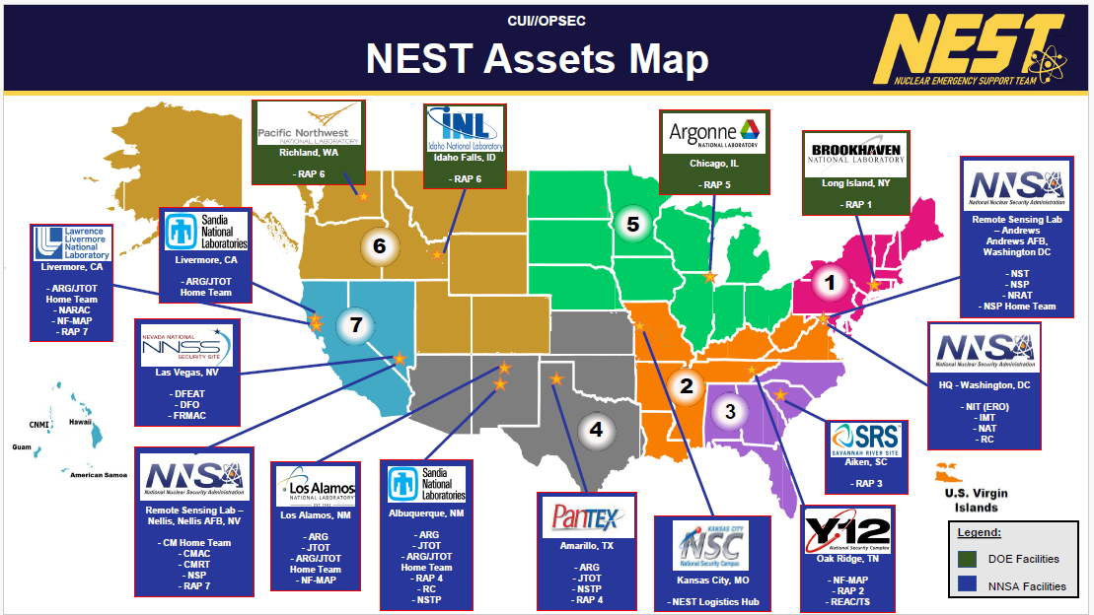

Slide 9
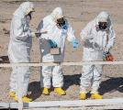

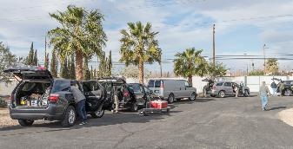
NEST – Radiological Assistance Program (RAP)
The Nation’s preeminent Federal first responders providing technical leadership and operational expertise to plan, prepare, and respond to radiological/nuclear crisis operations and consequence management events.
Agile, scalable, and rapidly-deployable Federal first response capability.
Leverages DOE’s scientific and operational expertise to enhance the Nation’s integrated response capability:
  Training and partnering with other Federal, tribal, State, and local agencies;
  Technical leadership and assistance during planning, preparedness, and response operations.
Notes:
CM – only post incident (don’t like); cont do hazard mitigation
Less linear, highlight things happening throughout
There is a lot going on that we do not exercise that we need to highlight.

Slide 10
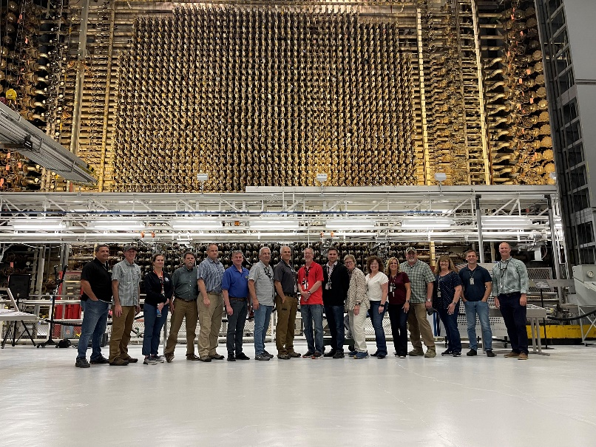
NEST – Radiological Assistance Program (RAP) Personnel
RAP Regions:
Regional Program Manager
Regional Operations Manager
Equipment Coordinator
Training Coordinator
Outreach Coordinator
Federal Team Leaders (FTL)
Laboratory personnel - about 30 per Region
Approximately 300 total RAP Team Members across the country.
Notes:
CM – only post incident (don’t like); cont do hazard mitigation
Less linear, highlight things happening throughout
There is a lot going on that we do not exercise that we need to highlight.

Slide 11
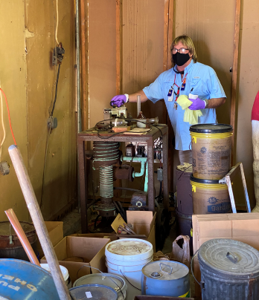
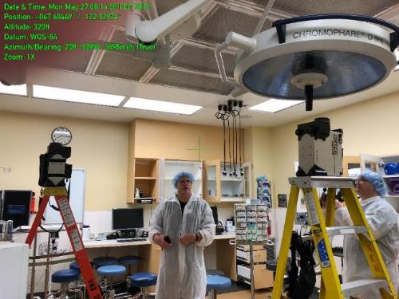
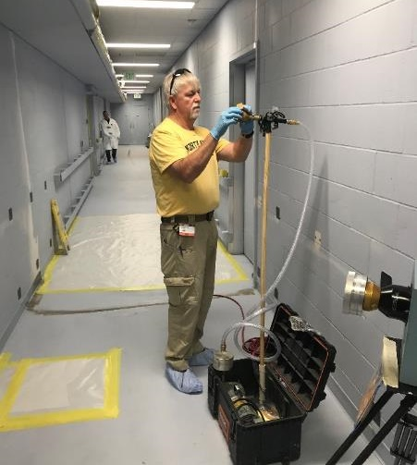
NEST – Radiological Assistance Program (RAP) Structure
RAP Deployable Teams:
Federal Team Leader (FTL): Federal leadership representing DOE/NNSA during deployment operations.
Team Captain (TC): Contractor management during a response to an accident or incident.
Team Scientist (TS): Provides technical data assessment and analysis.
Health Physics Support Personnel (HPSP): Responsible for executing the response mission as directed by the TC.
Standard team size of 8. Modified based on the event.
Notes:
CM – only post incident (don’t like); cont do hazard mitigation
Less linear, highlight things happening throughout
There is a lot going on that we do not exercise that we need to highlight.

Slide 12

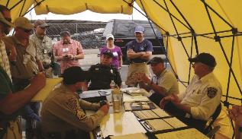
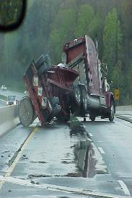
Radiological Assistance Program (RAP) Mission Areas
Crisis Response:
key role in NNSA’s counterterrorism response mission.
Joint training and exercises with FBI, DHS, and DoD.
Supporting mission partners at Special Events like the Super Bowl, National Political Conventions, and State of the Union Address.
Support law enforcement searches for lost or stolen radioactive materials.
Consequence Management: activities occurring after a known or suspected release of radioactive materials.
Characterize extent of incident and assess any contamination.
Advise decision-makers on courses of action to minimize danger to the public and property.
Regional Preparedness: Coordinate and conduct regional preparedness activities with other Federal, state/local/tribal governments for joint participation in meetings, training, drills, exercises, and support for domestic preparedness.

Slide 13
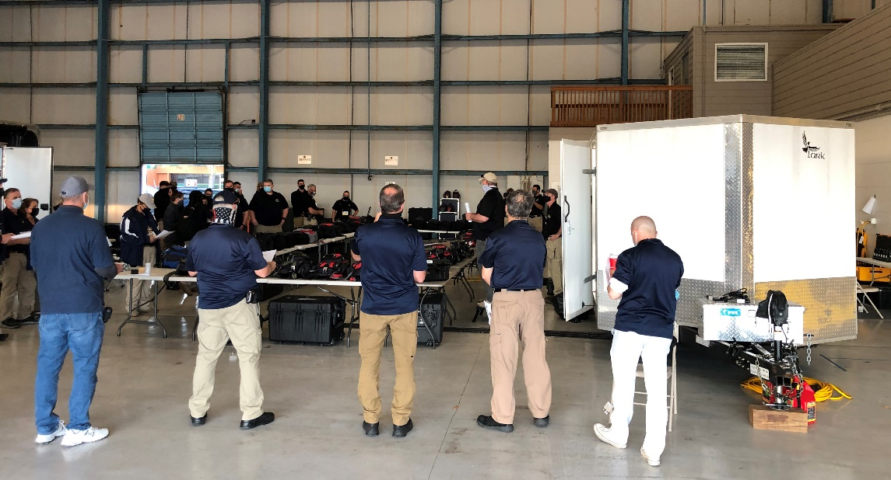
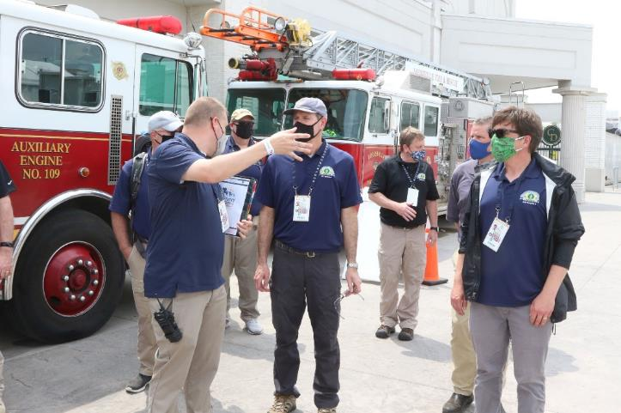

Radiological Assistance Program (RAP) Crisis Response
Crisis Response: Key role in NNSA’s counterterrorism response mission:
Joint training and exercises with FBI, DHS, and DoD
Supporting mission partners at Special Events like the Super Bowl, National Political Conventions, and State of the Union Address
Support law enforcement searches for lost or stolen radioactive materials

Slide 14
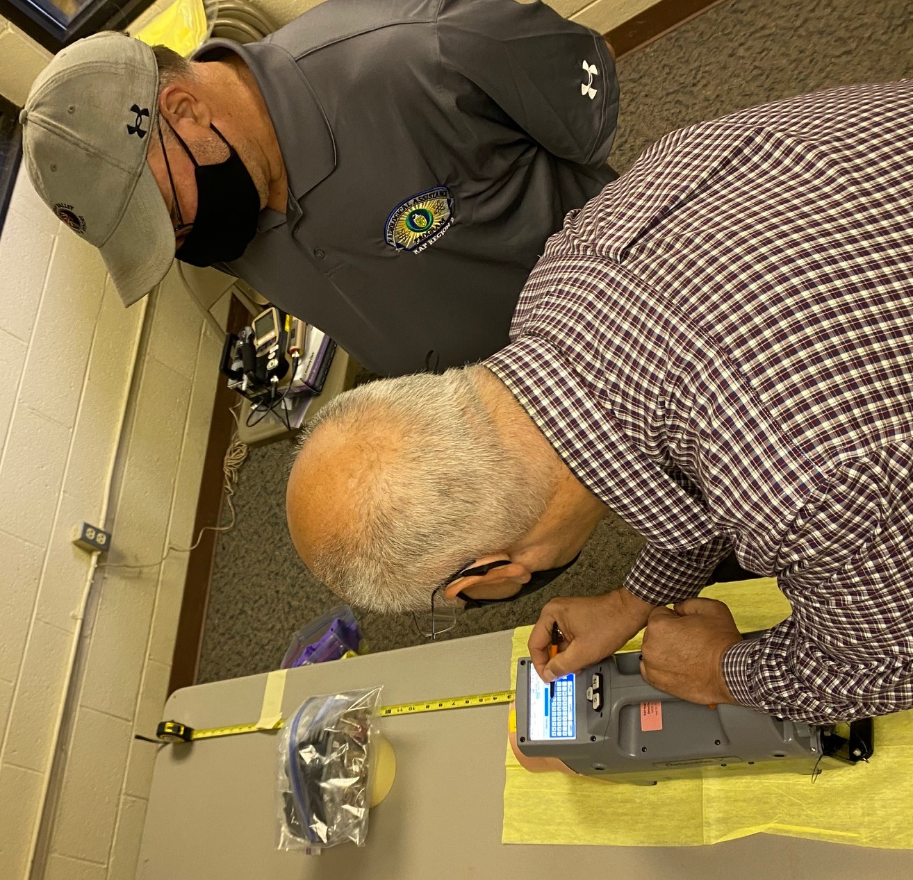
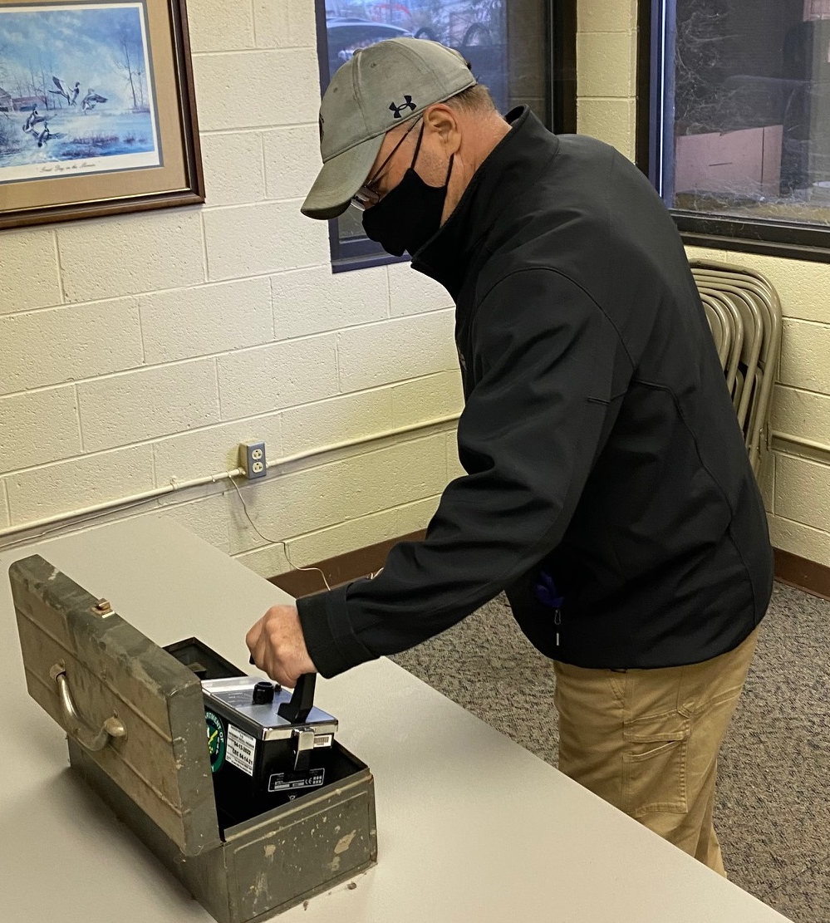
Radiological Assistance Program (RAP) Consequence Management
Consequence Management: activities occurring after a known or suspected release of radioactive materials.
Characterize extent of incident and assess any contamination
Advise decision-makers on courses of action to minimize danger to the public and property.

Slide 15
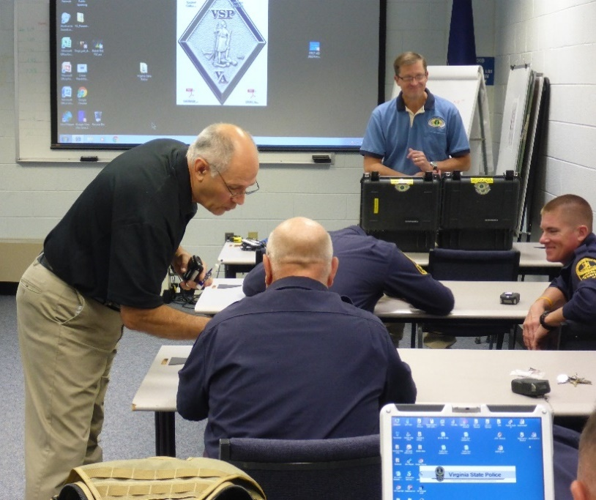
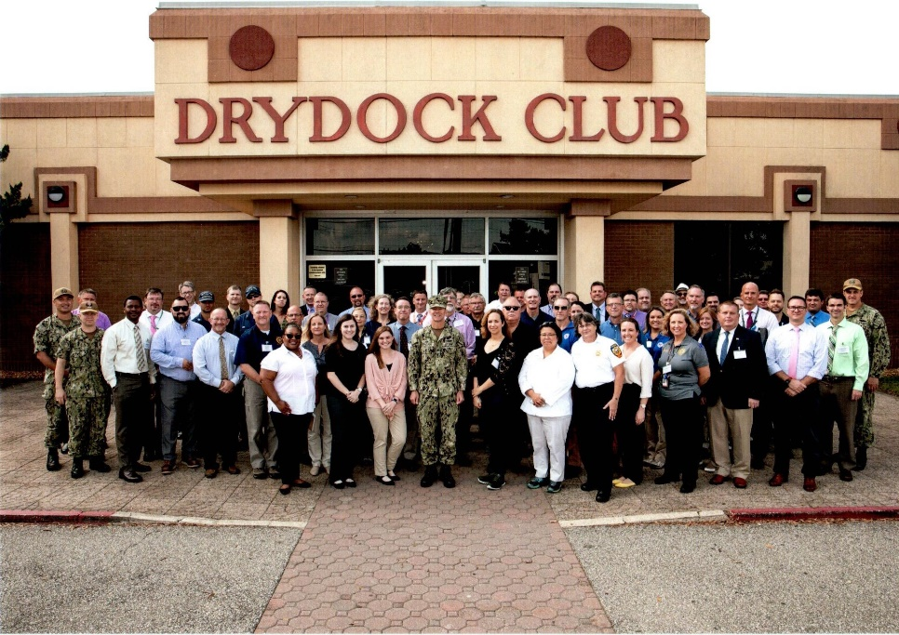
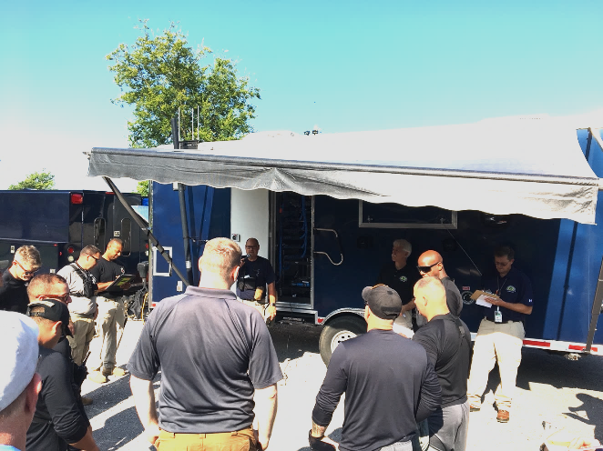
Radiological Assistance Program (RAP) Regional Preparedness
Regional Preparedness: Coordinate and conduct regional preparedness activities with other Federal, state/local/tribal governments for joint participation in meetings, training, drills, exercises, and support for domestic preparedness

Slide 16
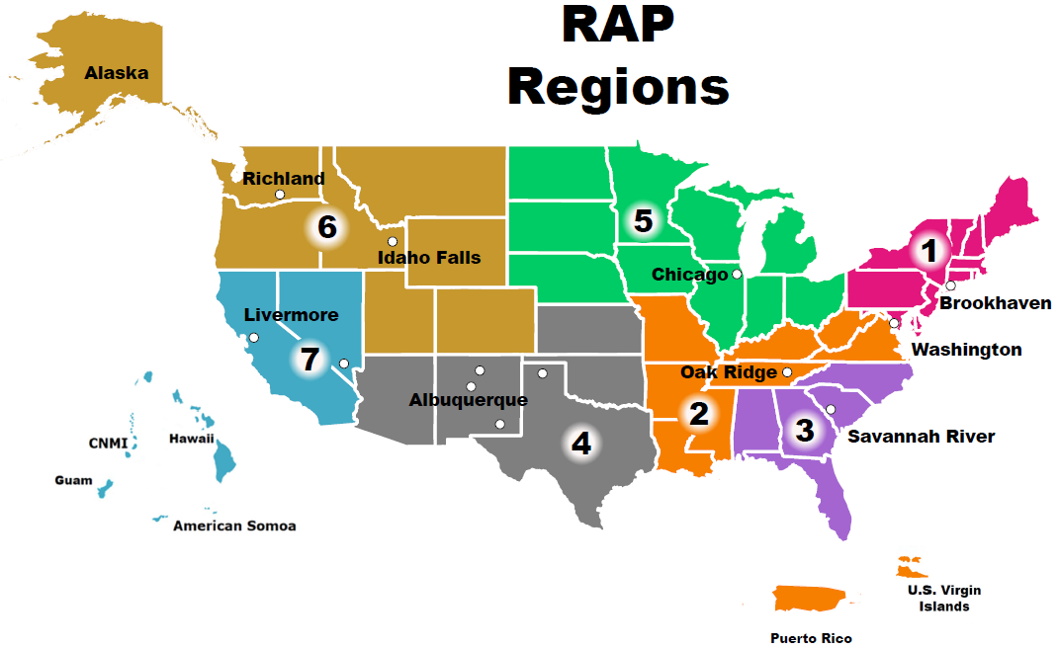
Radiological Assistance Program (RAP) Regions
Geographically regionalized to support rapid deployment in emergencies
Mobilized/Ready to deploy:
  within two hours of notification during normal working hours.
  within four hours of notification during off hours.

Slide 17
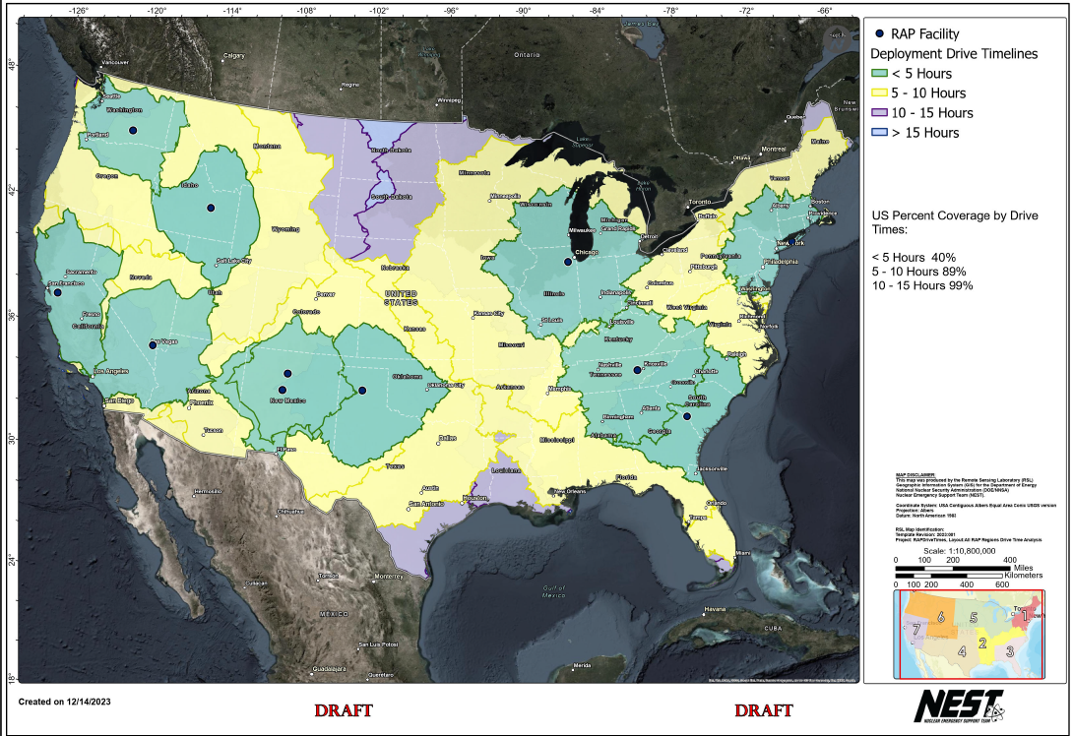
Radiological Assistance Program (RAP) Response Times

Slide 18
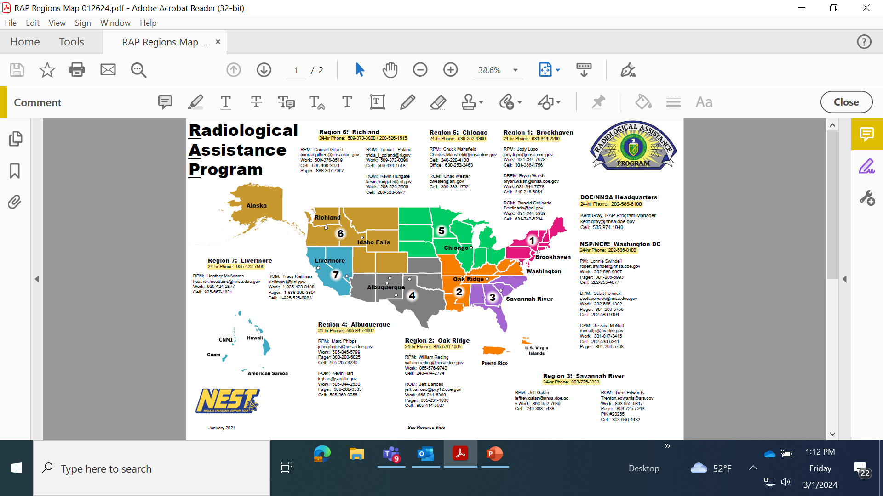
Radiological Assistance Program (RAP) POCs

Slide 19
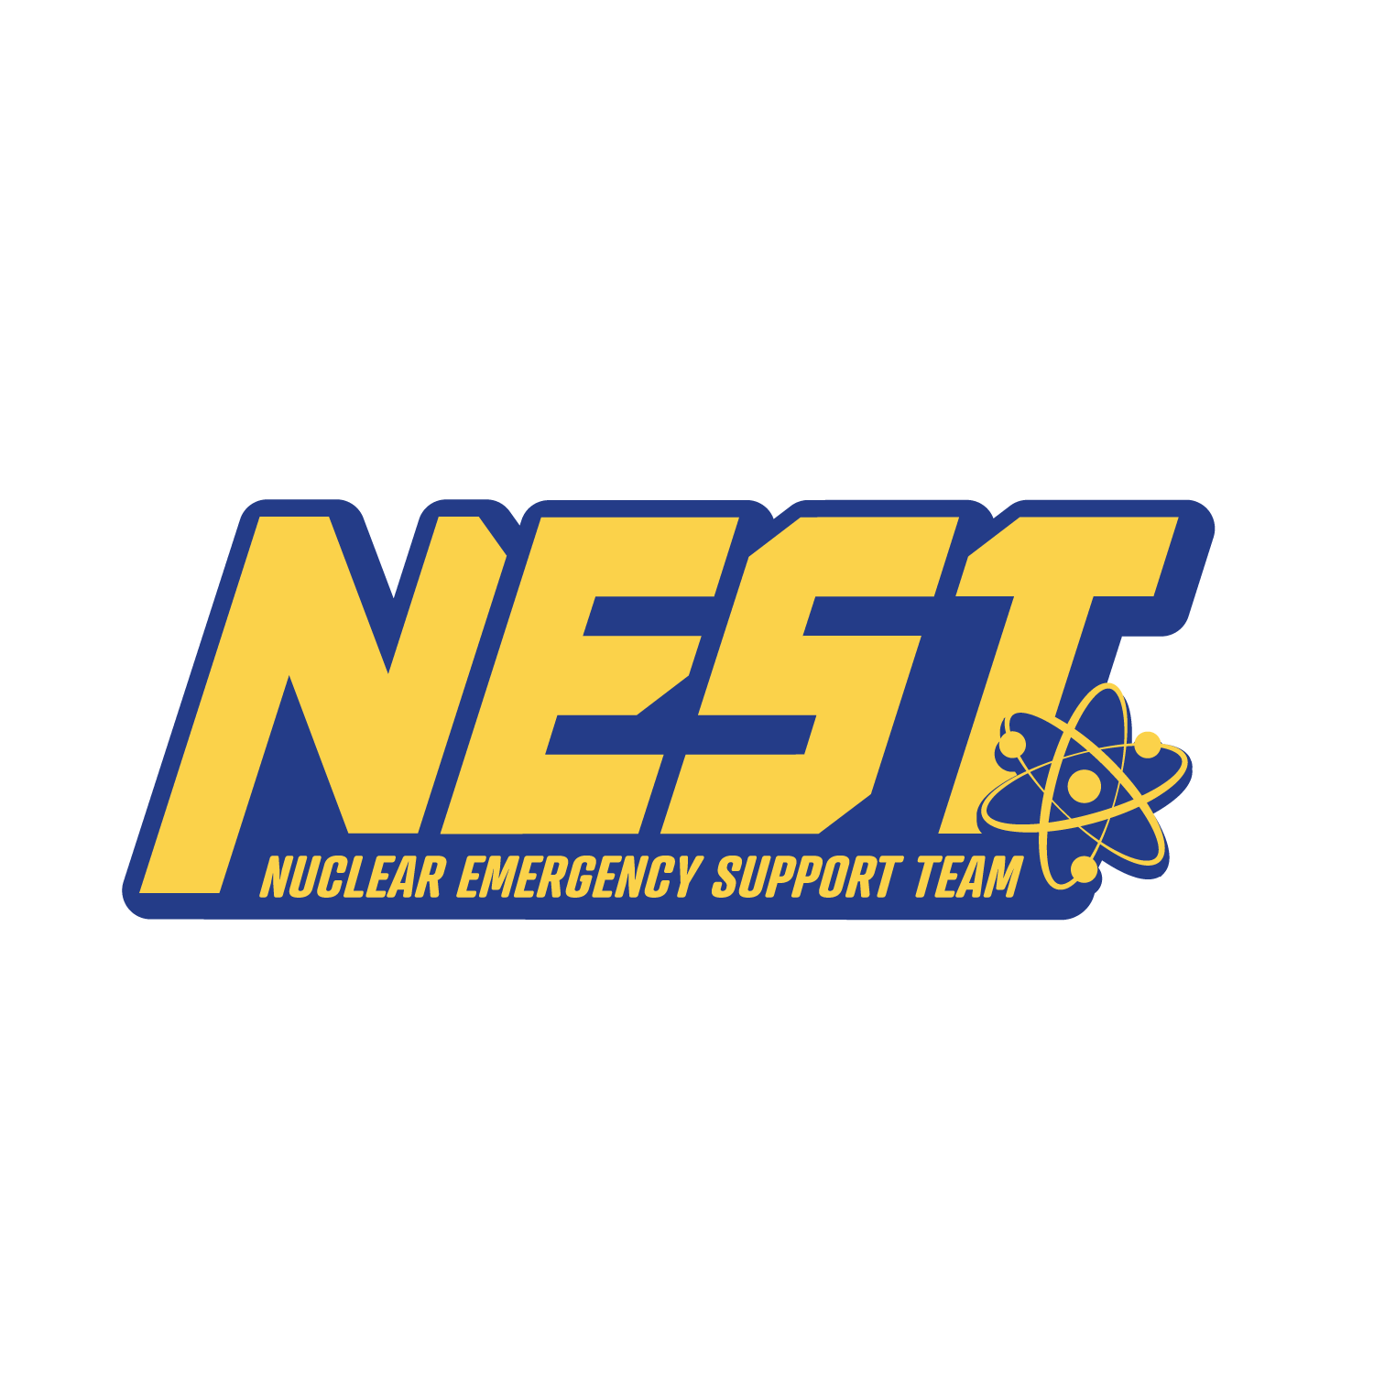
24hour Number
202-586-8100
HQs Watch Office
CTCP Website: https://nnsa.energy.gov/aboutus/ourprograms/ctcp

